Slide 1
FINANCIAL DECISION MAKING
Student name:
Student ID:

Slide 2

INTRODUCTION
The financial decision making is mainly a element for considering the useful process for a firm
Aim of the study is to explore the financial condition for Unilever Plc
It has conducted a financial ratio analysis and financial strategy mapping
Organizational engagement is also identified for exploration of process
Notes:
The decision of financial decision making is prepared based on the financial perspective of Unilever plc. Five years of financial ratio has been conducted that is useful for considering the financial perspective for the firm. Conducting a balance scorecard is further explored for considering the decision making for the firm.

Slide 3
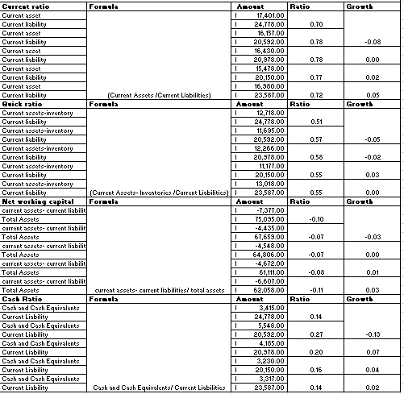
LIQUIDITY RATIO
The calculation of liquidity ratio is commonly measured the ability to resolve short obligation
Involvement of cash development activities are further involved with liquidity factor
Notes:
The financial analysis is generally explored 0.70 as the current ratio for 2021. The highlighting on Quick ratio and current ratio is for projecting a better improvement. The consideration of lower performance is highlighted.

Slide 4
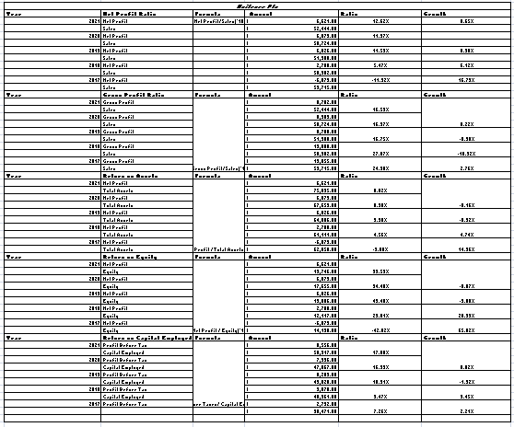
PROFITABILITY RATIO
The financial profitability is highlighted on earnings of a firm (Jha et al. 2021)
Lower performance by considering threshold value 20%
Notes:
The consideration of the process is involved in developing the profitability aspects. It has earned a lower margin in GP and NP margin. Presented a lower efficiency in considering the earning for the firm

Slide 5
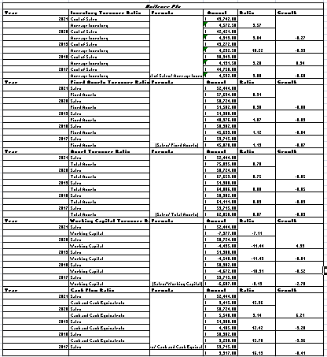
EFFICIENCY RATIO
The computation of efficiency ratio is commonly measured the financial ability for a firm
Identification of generating is also involved in this computation of process
Notes:
The consideration of factors is also considered for projecting the ability. It has initiated a performance by evaluating its asset and inventory turnover

Slide 6
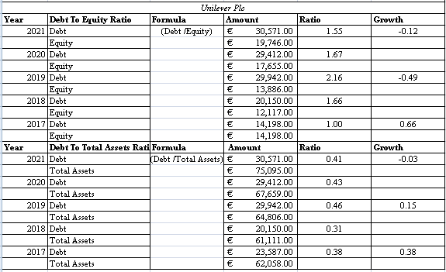
SOLVENCY RATIO
The estimation of solvency ratio is operated for projecting the financial value as per the process
Considering of ratio value is indicated as 1.55 in 2021 and 0.41 as Debt to asset in 2021
Notes:
The consideration of solvency ratio is generated 1.55 as per 2021. The performance of the process provides an overview of a higher solvency value.

Slide 7
INTERPRETATION OF RESULT
The analysis is indicated a lower liquidity position in 2021
Net working capital and cash ratio is considered as a lower position (Tanizaki et al. 2019)
The consideration of profitability factor is evaluated 12.62%
Computation indicates 8.82% as 2021 and 33.53% as ROE
Notes:
The computation of liquidity factor is generally exposed to a lower position based on the market performance. It is indicated a lower ability of solving its short obligations

Slide 8
CONTD….
The consideration of debt factor is also controlled for in solvency value
Lower ability of resolving long debt (Buele et al. 2021)
It has indicated 9 as inventory turnover, 0.91 as fixed asset
The computation of asset value as 0.70 and cash flow as 15.36
Notes:
The consideration of financial value indicates a lower leverage factor. The financial value indicates a lower performance for the process.

Slide 9
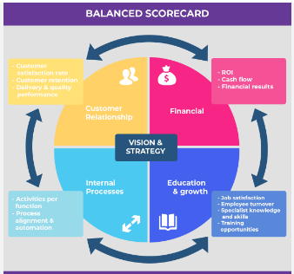
BALANCE SCORECARD COVERING FOUR ASPECTS
The involvement of balance scorecard has considered four aspects for a firm
Involvement of financial, customer, business process, learning growth for the process
It has included different aspects for exploring the current position
These parameter is useful for considering the approaches
Strategic measures are involved for developing customer aspects
Notes:
The analysis of these perspectives is useful for considering the financial approaches. Consideration of KPI is initiated for exploring the measurement for developing the position. A comprehensive market approach is introduced with this factor.

Slide 10
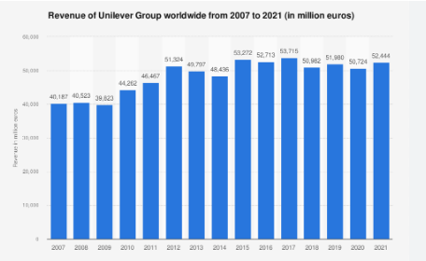
CONTD…
Financial
Providing a consistent growth in retail market
Make a improvement by considering a market (Ningsih & Sari, 2019)
Development of better cash flow evaluation
Notes:
The analysis of financial prospects has mainly aimed to make a prominent consistency for the retail market. It has made a growth in improving the retail market by conducting better market approaches. Unilever has planned for improving its market position by considering better market approaches. The developments of activities are considered for improving its cash flow in following years.

Slide 11
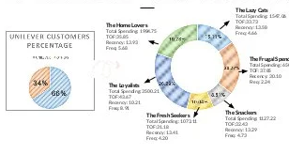
CONTD…
Providing a value product to every household person
The distribution is mainly involved for considering a better approaches
Target a higher range of customer in the market
Involvement of providing a better experience towards the customer
Notes:
The consideration of household product is commonly involved in considering a range of activities for the organization value. The consideration is commonly measured as a broader targeting customer for Unilever. The involvement of experience is further explored for contributing to better involvement for the process. It includes the target customer for improving the business process

Slide 12
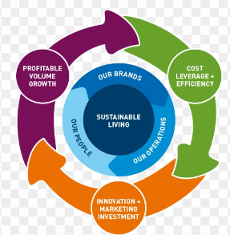
CONTD…
Improvement in quality of product types
Continuous development in service offering (Horobet et al. 2021)
Proper checking of quality and sustainable business process
Incorporation of faster business development and agile involvement
Notes:
The incorporation of quality products for the business development has an improved financial perspective for the process. The changes in the business value by offering valued goods in the market are also considered as a higher business process. Involvement of faster business processes for generating a higher consideration of value.

Slide 13

CONTD…
Learning growth
Providing proper training program
Better approaches for underpinning a sustainable learning development
Addressing of issues by providing a proper solution
Improvement in developing the customer process
Notes:
The consideration of business processes is commonly involved in considering the business process. The enrollment of business activities are further developed for improving the training and development process. Sustainable growth can be provided towards the firm by giving better approaches for improvement. Addressing issues in approaching the customer is also addressed and developed in proving the position.

Slide 14

MISSION AND VISION
Vision for changing environmental footprint and make a positive social impact (unilever.com, 2022)
Providing a nutrition, hygiene and personal care for the commonplaces
Notes:
vision
The consideration of the vision statement is to reduce the carbon footprint by increasing the position scenario for the social consideration. It is also effective for exploring the usage of living commonplaces. The involvement of a vision statement is included for developing the product evaluation.
Mission
The company has taken to provide vitality towards the life consideration. The developments of activities are further explored for providing hygiene and also the personal care for the brands. The developments for the brands are also highlighted for considering the analysis.

Slide 15

STRATEGY MAPPING WITH BALANCE SCORE CARD
Target
Consideration of financial effectiveness for improving position (theguardian.com, 2022)
Financial effectiveness is also required for cash flow development
Initiatives
Proper implication strategy towards the market development
Development of product for exploring the cash flow
Notes:
The developments of activities are further initiated for exploring the process. As per the target measurement, it has developed the cash flow improvement, and made a growth in retaining the market. It has developed for considering the marketing activities.

Slide 16
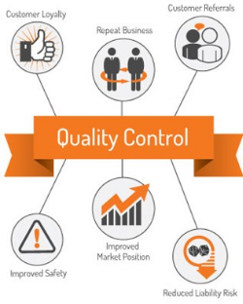
CONTD…
Target
It is targeted to manufacture value product
Higher range of customer target and providing a best experience (Wildatunjanah & Suparningsih)
Initiatives
It has developed the customer base by increasing the target market
Improvement in quality checking process
Notes:
The development of market processes is commonly involved for considering a better market value. It has targeted most of the customers and provided a better experience for improving the position. It has developed the target market and it is involved in a better quality checking process.

Slide 17
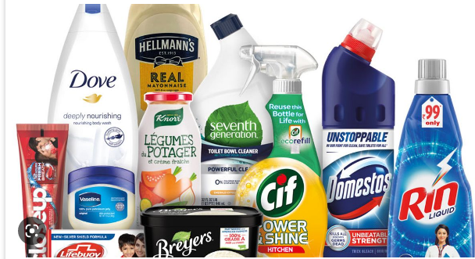
CONTD…
Target
Improvement in service offering
Consideration of sustainable improvement of product
Initiatives
The integration of business process by considering a proper checking
The development of improving the product value
Notes:
The change in the product value is mainly considered for improving the customer process. The improvements of activities are further processed for developing the business condition. Consideration of initiatives involves the application of business value for further contribution.

Slide 18
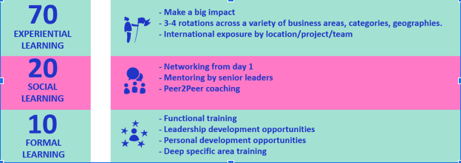
CONTD…
Target
The consideration of learning development is mainly aimed
Improvement in customer process is also considered as aimed
Initiatives
Changes in strategic approach for make a learning growth
Customer centric seminar and classes for the employees (Sasongko et al. 2021)
Notes:
The implementation of the initiatives mainly developed the target perceptions that are involved in this. The initiation of learning growth is also made for considering the customer process. The implementation of strategic improvement is also included in this context. The arrangement classes and employee feedback is commonly involved as per the process.

Slide 19

ENGAGEMENT AND REFLECTION OF GROUP WORK
The presentation has been made by collecting the data of Unilever by group
I have collected the information by considering the annual report by firm
Considering the group work has involved for exploring the decision for the process
I have collected sufficient knowledge by gathering the business initiatives
Notes:
The consideration of group presentation involves the activities. I was involved in collecting the information regarding the financial consideration of this report. 5 years of data has been explored by considering the presentation of the group process

Slide 20

CONCLUSION
It can be concluded that the performance for Unilever is lower
Different aspects has been undertaken with the process
The identification of strategy mapping
Notes:
The evaluation is also considered by considering the strategy mapping and financial analysis process. The consideration of process is also involved for the explanation

Slide 21

RECOMMENDATION
The improvement is business process is also required to change
The liquidity and also profitability is required to improve
Financial strategy is required to change
Notes:
The consideration of financial analysis is required to consider. The consideration of financial value is needed to develop. The improvement in collecting the strategy might develop the position.

Slide 22
REFERENCES
Buele, I., Mora, A., & Santiago, S. (2021). Ecuadorian wholesale and retail trade companies: analysis of the financial situation and bankruptcy forecast under altman Z-score. Academy of Accounting and Financial Studies Journal, 25(1), 1-11. Retrieved on 3rd November from:https://www.academia.edu/download/65944726/Ecuadorian_Wholesale_and_Retail_Trade_Companies_1528_2635_25_1_638.pdf
Horobet, A., Curea, S. C., Smedoiu Popoviciu, A., Botoroga, C. A., Belascu, L., & Dumitrescu, D. G. (2021). Solvency risk and corporate performance: a case study on European retailers. Journal of Risk and Financial Management, 14(11), 536. Retrieved on 3rd November from: https://www.mdpi.com/1911-8074/14/11/536
Jha, S., Yang, E., Almagrabi, A. O., Bashir, A. K., & Joshi, G. P. (2021). Comparative analysis of time series model and machine testing systems for crime forecasting. Neural Computing and Applications, 33(17), 10621-10636. Retrieved on 3rd November from: https://www.researchgate.net/profile/Ali-Bashir-4/publication/341475391_Comparative_analysis_of_time_series_model_and_machine_testing_systems_for_crime_forecasting/links/5f3dbd2892851cd30206bf1e/Comparative-analysis-of-time-series-model-and-machine-testing-systems-for-crime-forecasting.pdf
Ningsih, S., & Sari, S. P. (2019). Analysis Of The Effect Of Liquidity Ratios, Solvability Ratios And Profitability Ratios On Firm Value In Go Public Companies In The Automotive And Component Sectors. International Journal of Economics, Business and Accounting Research (IJEBAR), 3(04). Retrieved on 3rd November from: http://jurnal.stie-aas.ac.id/index.php/IJEBAR/article/view/752
Sarraf, F., & Nejad, S. H. (2020). Improving performance evaluation based on balanced scorecard with grey relational analysis and data envelopment analysis approaches: Case study in water and wastewater companies. Evaluation and program planning, 79, 101762. Retrieved on 3rd November from:https://ems.uniza.sk/wp-content/uploads/2019/06/EMS_1_2019_02_Krylov.pdf
Sasongko, H., Ilmiyono, A. F., & Tiaranti, A. (2021). FINANCIAL RATIOS AND FINANCIAL DISTRESS IN RETAIL TRADE SECTOR COMPANIES. JIAFE (Jurnal Ilmiah Akuntansi Fakultas Ekonomi), 7(1), 63-72. Retrieved on 3rd November from: https://scholar.archive.org/work/iebvmzryk5drvjckctqbwsxcx4/access/wayback/https://journal.unpak.ac.id/index.php/jiafe/article/download/3380/pdf
Tanizaki, T., Hoshino, T., Shimmura, T., & Takenaka, T. (2019). Demand forecasting in restaurants using machine learning and statistical analysis. Procedia CIRP, 79, 679-683. Retrieved on 3rd November from: https://www.sciencedirect.com/science/article/pii/S2212827119301568/pdf?md5=daf4b8e100ae88b2d75810a9dfc2d8c3&pid=1-s2.0-S2212827119301568-main.pdf
theguardian.com (2022) .suitability report. Retrieved on 3rd November from: https://www.theguardian.com/sustainable-business/profile-unilever
unilever.com (2022) Retrieved on 3rd November from: https://www.unilever.com/our-company/at-a-glance/#:~:text=Unilever%20at%20a%20glance,right%20way%20drives%20superior%20performance.
Wildatunjanah, E. S., & Suparningsih, B. (2019). The Effect of Debt to Equity Ratio and Pricer Earning Ratio on Stock Price with Moderating as BI Rate Variable in Retail Sector Companies Listed in Indonesia Stock Exchange (IDX). East African Scholars Journal of Economics, Business and Management, 2(6), 307-317. Retrieved on 3rd November from:https://www.easpublisher.com/media/articles/EASJEBM_26_307-317_c.pdf

Slide 23


